Slide 1
Thinking like a sociologist
Introduction to Sociology: Class 2

Slide 2
Class 2
Please log in to your Top Hat account (app.tophat.com)
If you need a syllabus, please come grab one from up front.

Slide 3
questions to answer
How do we as humans perceive the world around us?
What does it mean to use our sociological imagination?
Why is it hard to use our sociological imaginations?
Why is it important to use our sociological imaginations?
How do our circumstances affect our life chances?

Slide 4
top hat poll:
did your high school look more like New Britain or Berlin?
New Britain
Berlin
where we grow up shapes our sense of what is normal
https://www.npr.org/2019/07/25/739494351/separate-and-unequal-schools

Slide 5
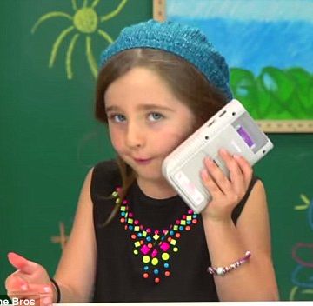
how humans see the world
perspective
=
biography
+
history
who you are
where you are
gender
race
age
education
income
in time
in space
in society

Slide 6
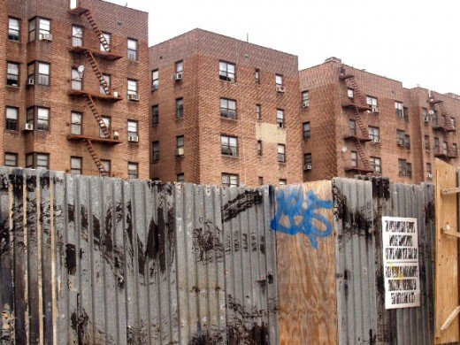
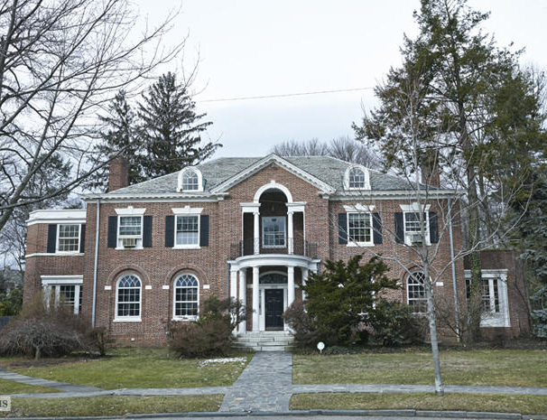
imagining sociologically at fieldston
3 miles
housing project, South Bronx
mansion, North Bronx

Slide 7
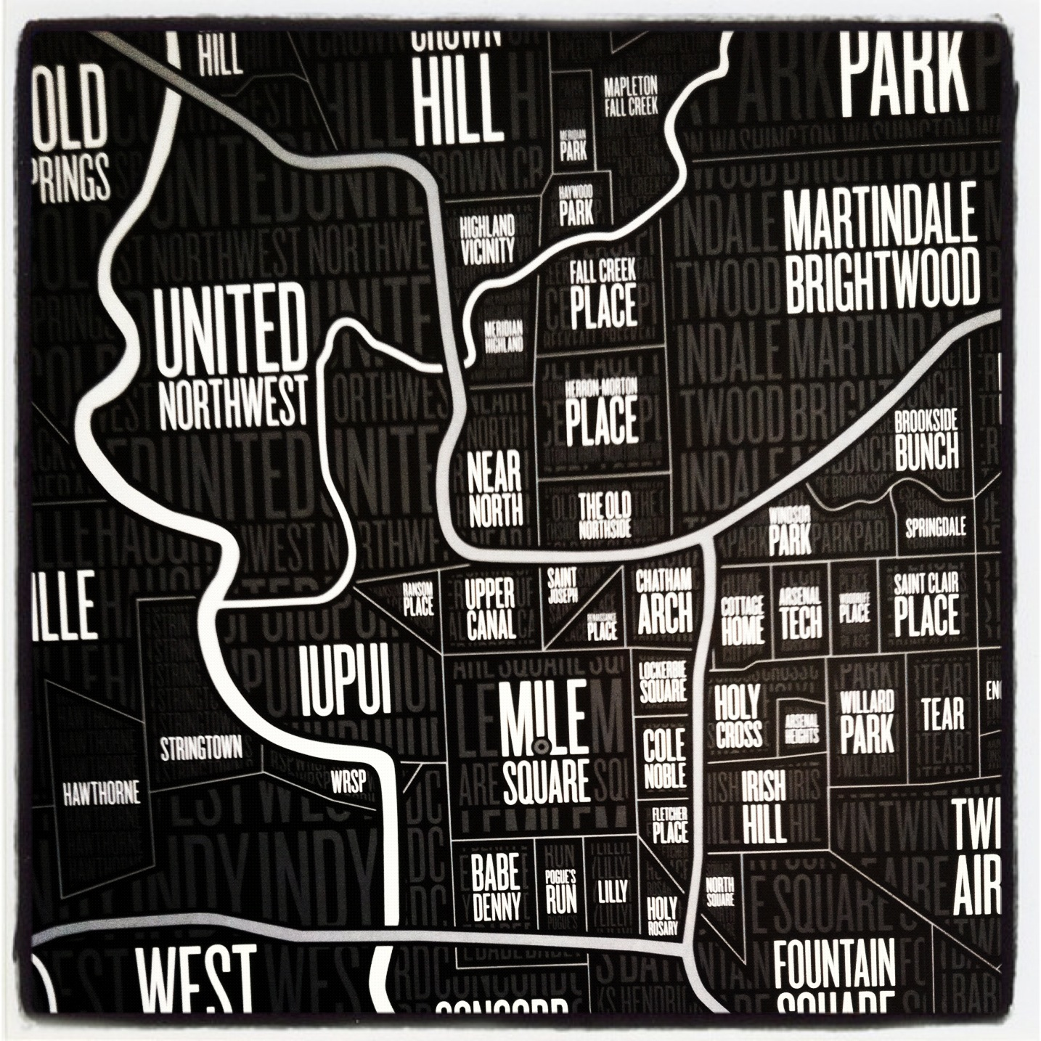
moving to opportunity
compared to a poor kid who moves to Indy, a poor kid who moves to Carmel will earn $6,000 more/year as an adult
affluent neighborhoods have
less crime
more stability
better-resourced schools
different expectations
http://www.nytimes.com/interactive/2015/05/03/upshot/the-best-and-worst-places-to-grow-up-how-your-area-compares.html

Slide 8
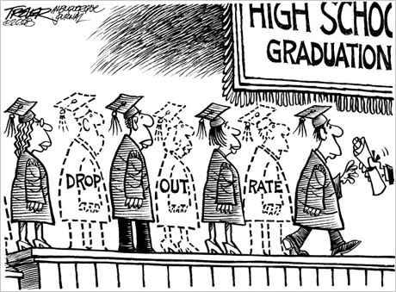
success just out of reach
school outcomes vary widely, even in small geographic areas
Carmel: very affluent; scores 2.6 grades > average
Indianapolis: lower income; scores 1.2 grades < average
in low-income neighborhoods, even really smart kids drop out
http://www.nytimes.com/interactive/2016/04/29/upshot/money-race-and-success-how-your-school-district-compares.html

Slide 9
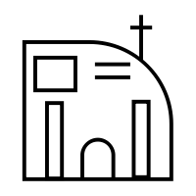
structure vs. agency
structure is important, but agency also matters
ivy league grads have incomes similar to those of students who got into ivy league colleges but attended state schools, instead
choices

Slide 10
for next class
how does functionalist theory explain inequalities in our society?
how does conflict theory explain inequalities in our society?
how does symbolic interactionism explain inequalities in our society?
how do sociologists use theories?
what is the difference between macrosociology and microsociology?
how is sociology different from other disciplines?

