Slide 1
Thinking like a sociologist
Introduction to Sociology: Class 2

Slide 2
questions to answer
How do we as humans perceive the world around us?
What does it mean to use our sociological imagination?
Why is it hard to use our sociological imaginations?
Why is it important to use our sociological imaginations?
How do our circumstances affect our life chances?

Slide 3
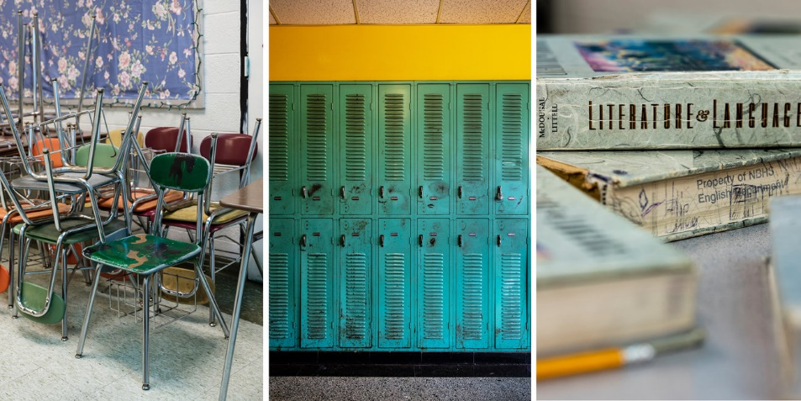
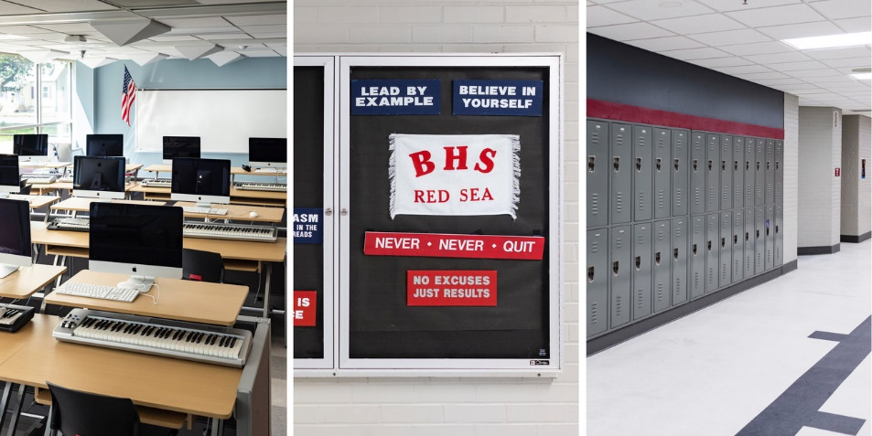
top hat poll:
did your high school look more like New Britain or Berlin?
New Britain
Berlin
https://www.npr.org/2019/07/25/739494351/separate-and-unequal-schools

Slide 4
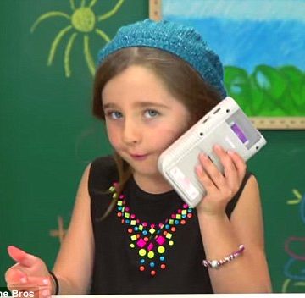
how humans see the world
=
+
a
a
a
a
a
a
a
a

Slide 5
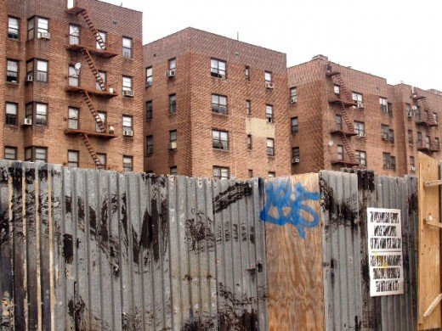
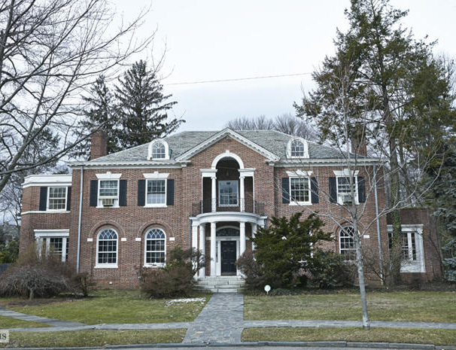
imagining sociologically at fieldston
3 miles

Slide 6
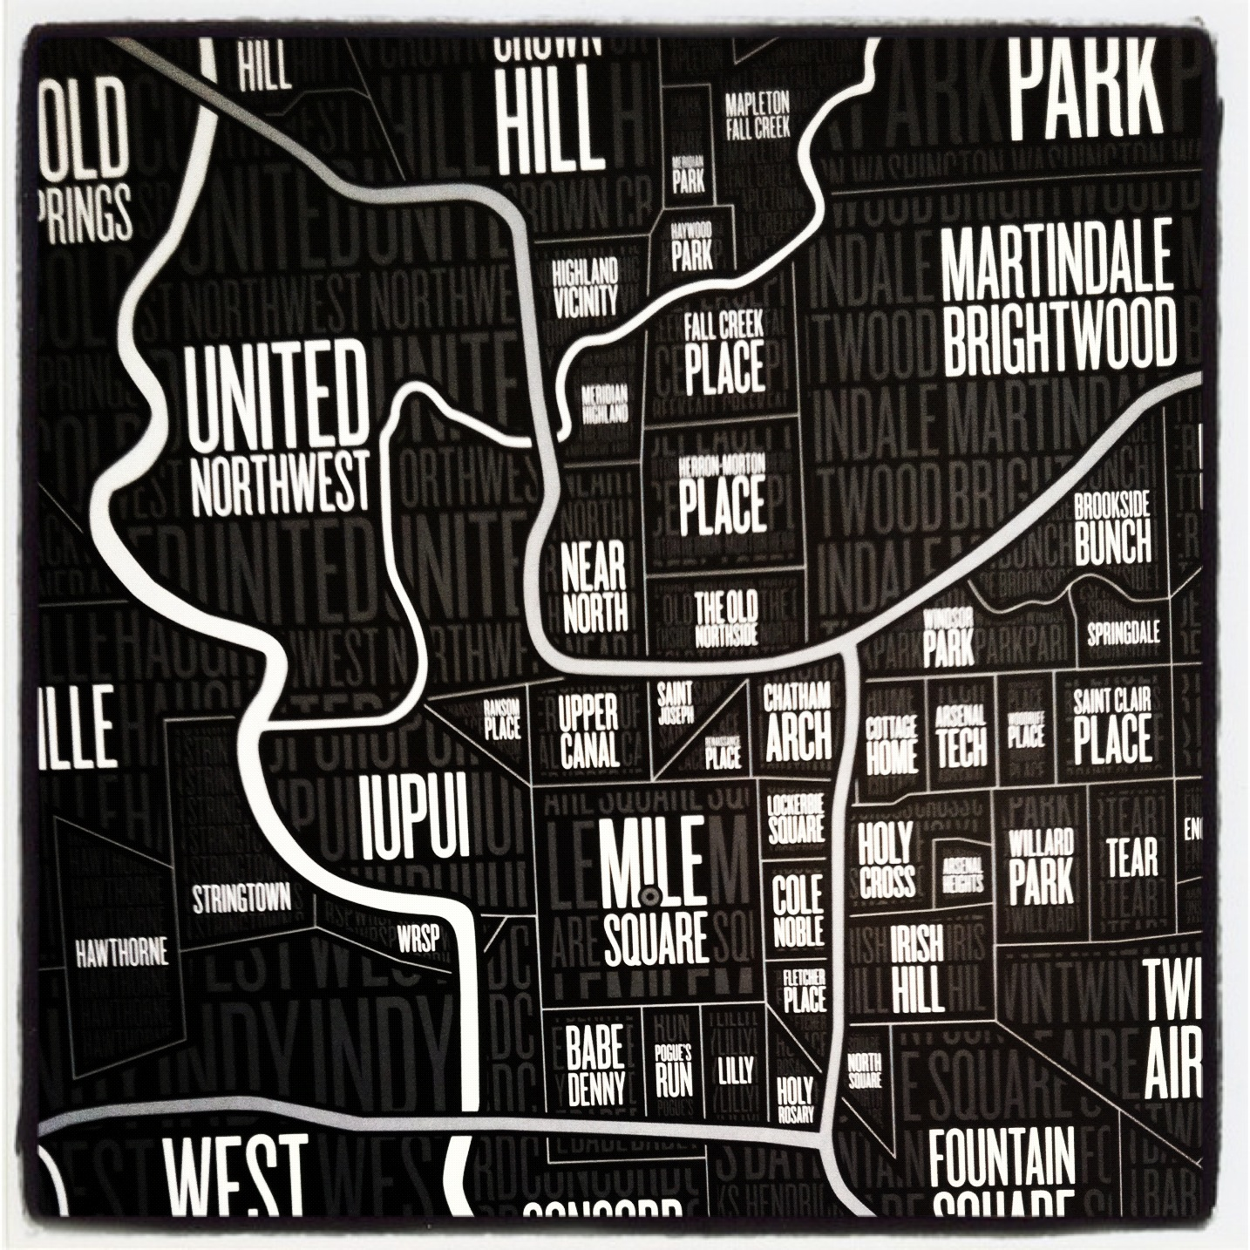
moving to opportunity
a
a
a
a
http://www.nytimes.com/interactive/2015/05/03/upshot/the-best-and-worst-places-to-grow-up-how-your-area-compares.html

Slide 7
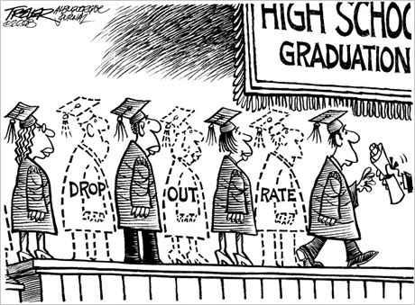
success just out of reach
http://www.nytimes.com/interactive/2016/04/29/upshot/money-race-and-success-how-your-school-district-compares.html

Slide 8
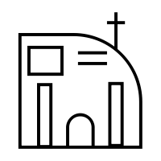
structure vs. agency
choices

Slide 9
for next class
how does functionalist theory explain inequalities in our society?
how does conflict theory explain inequalities in our society?
how does symbolic interactionism explain inequalities in our society?
how do sociologists use theories?
what is the difference between macrosociology and microsociology?
how is sociology different from other disciplines?

